Slide 1

Java Based TCP Chat-Room
Computer Networks (2EC702) Project
Submitted to Dr. Sachin Gajjar
~by (20BEC123) Soumik Mohapatra
(21BEC027) Aum Dhabalia

Slide 2
Content
Problem Statement
Overview on Chat applications
Introduction to TCP
Introduction to Sockets
Approach
Block Diagram (Java Client-Server Model)
Tools and technology used
Output
Conclusion

Slide 3
Problem Statement
To implement TCP based chat application in Java programming language.

Slide 4
Overview on Chat Applications
A chat application is a messaging service platform where multiple clients communicate with each other either in group or one-to-one manner.
Allows real-time communication which can be video-chat, audio-chat or text-chat.
Popular Apps: WhatsApp, Microsoft Teams, Google Meet, etc.
Uses a client-server architecture for managing communication between multiple clients.

Slide 5
Introduction to TCP
Transmission Control Protocol
Connection-Oriented Protocol
Communication standard enabling device and application to exchange messages over a network.
Follows TCP/IP model suite
Features :-
Reliability : error detection, packet retransmission, packet sequencing
Connection maintenance
Security and precedence
Full-Duplex Connection
Graceful Shutdown

Slide 6
Introduction to Socket
A socket is an endpoint in a two-way communication channel that carries data between application programs.
Sockets work at the application layer, binding an IP address to port number to communicate information about the client device, destination server and the applications involved.
Types of sockets :-
Connection-oriented sockets (TCP, HTTPS, SMTP)
Connectionless sockets (UDP)

Slide 7
Approach
A server is initialized to listen for incoming client connections.
Clients request server for establishing connection.
Server accepts connections of incoming clients.
Each client sends a message to the server and the server relays that message to all other connected clients via broadcasting the message.

Slide 8
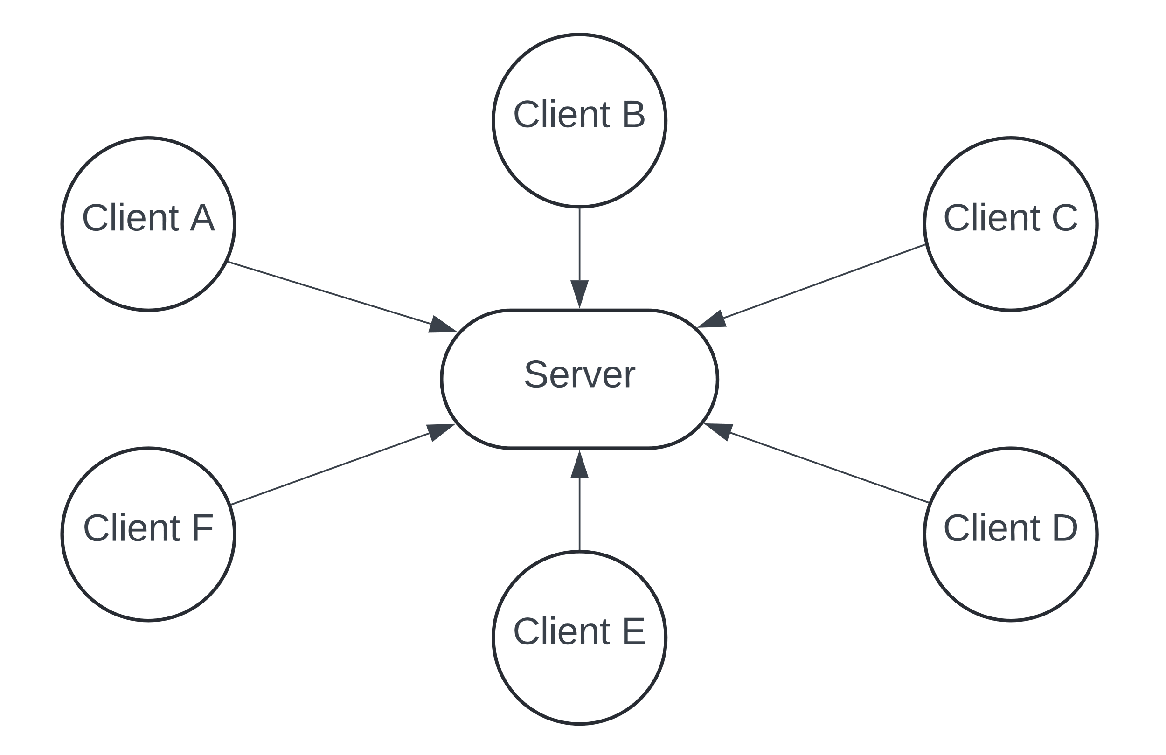
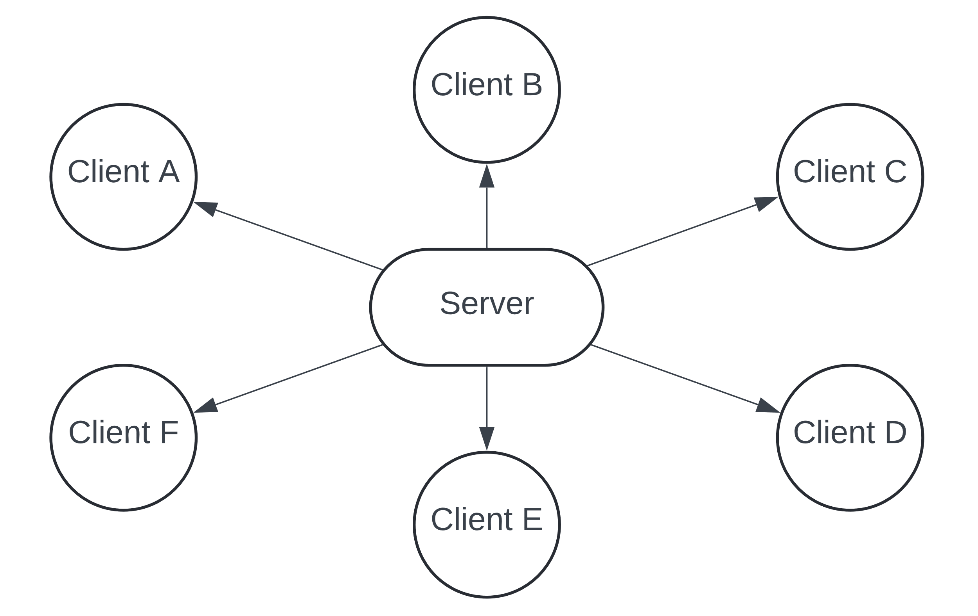
Java Client-Server Model
Server broadcasts messages to all clients
Clients send messages to server

Slide 9
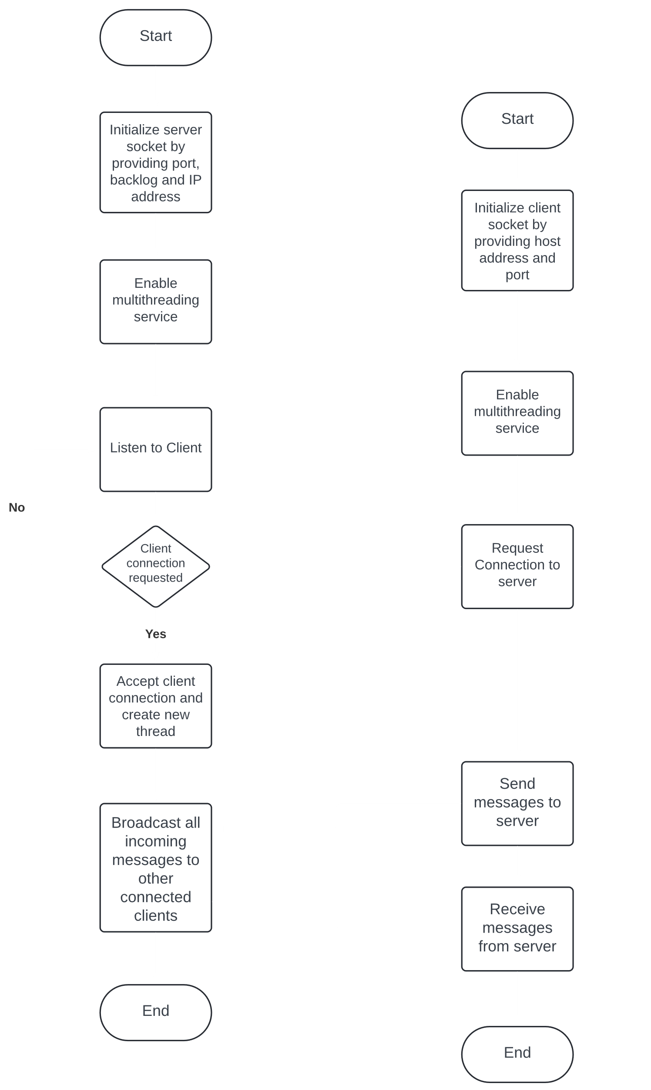
Java Client-Server Model (Contd.)

Slide 10
Tools and Technology used
Platform : Windows OS
Editor : Notepad++
Language : Java programming environment.
Programming Concept : Socket Programming in Java

Slide 11
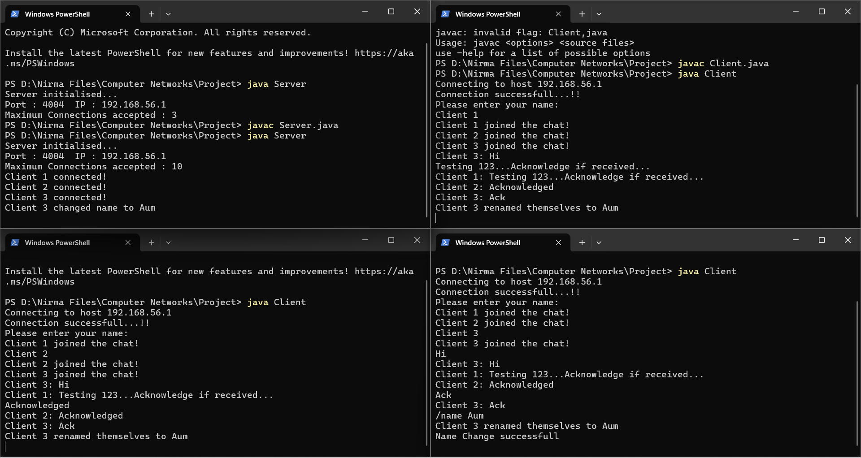
Output

Slide 12
Conclusion
Learned Socket programming in Java.
Learned transmission control protocol (TCP).
Explored concept of multi-threading for managing real-time client communication management.

Slide 13
References
[1]. Learning Network Programming with Java by Richard M Reese
[2]. Java Network Programming (Javatpoint)
[3]. ​Simple Chat-Room in Java

Slide 14
Thank You

